Slide 1
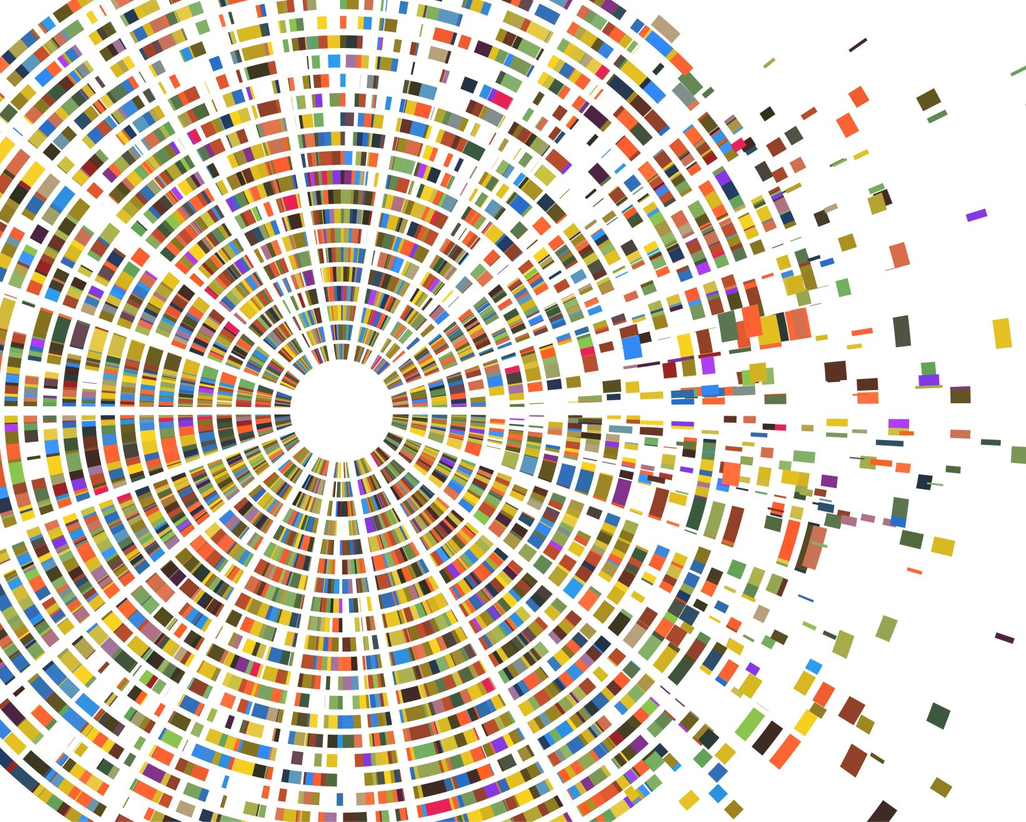
DATA ANALYSIS FOR R FITNESS
By:
Rohan Sanwal

Slide 2
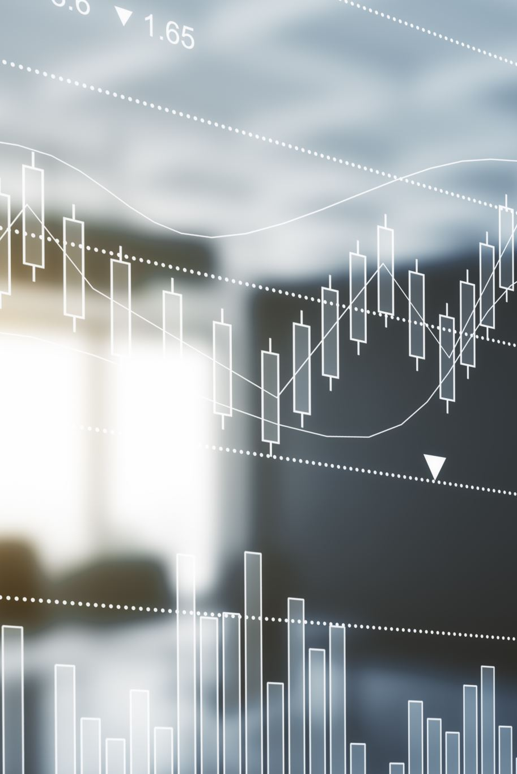
AIM
How Can a Wellness Technology Company
Market it’s products to a customers

Slide 3
About R Fitness
J.Carlson and S.Sharma founded R Fitness, a high-tech company that manufactures health-focused smart products.
Carlson used her background as an artist to develop beautifully designed technology that informs and inspires people around the world. Collecting data on activity, sleep, stress health has allowed R Fitness to empower people with
Knowledge about their own health and habits. Since it was founded in 2013, R Fitness has grown rapidly and quickly
Positioned itself as a tech-driven wellness company.
By 2016, R Fitness had opened offices around the world and launched multiple products. R Fitness products became available
S.Sharma knows that an analysis of R Fitness’s available consumer data would reveal more opportunities for growth. She has
Asked the marketing analytics team to focus on a R Fitness product and analyze smart device usage data in order to gain
Insight into how people are already using their smart devices. Then, using this information, she would like high-level recommendations for how these trends can inform R Fitness marketing strategy.

Slide 4
Data Analysis Factors
Manager asks you to analyze smart device usage data in order to gain insight into how consumers use R Fitness smart devices.
She then wants you to select one R Fitness product to apply these insights to in your presentation.
And show a specific device that has been used by the customers on daily basis
So that the marketing team could plan ads as per the market cap

Slide 5
Data Collection
The data collected consists of all the data that the Fitbits produce and collect on the daily bases and are stored in the form of Excel files
The data mainly consists of the number of steps taken by an individual, the distance travelled, calories burned.
The distance travelled data is further divided into very active, moderately active and light active depending upon the pace and intensity with which the user paces it’s walk
The data is then provided to us via mail by our manager
We get the data via mail and we create a folder named R Fitness data
We then copy the original data in our system where we created the new folder named R Fitness data

Slide 6
Data Profiling
After saving the file in the system under the R Fitness folder I renamed it to Daily activities_report from dailyactivity_merged then I examined the data that it has, getting to know my data better.
Looking at the data I have columns namely Id, ActivityDate, TotalSteps, TotalDistance, TrackerDistance, LoggedActivitiesDistance, VeryActiveDistance, ModeratelyActiveDistance, LightActiveDistance, SedentaryActiveDistance, VeryActiveMinutes, FairlyActiveMinutes, LightlyActiveMinutes, SedentaryMinutes and Calories.
Looking at the data in ActivityDate column shows some inconsistency
Also the column names doesn’t seem to be following the standard nomenclature
Also LoggedActivitesDistance doesn’t seem to make any sense as the data mostly has value as zero
This needs to be confirmed with the management via mail to check for the relevance of this column
The distance related column also needs to be confirmed as is it in Km or miles.

Slide 7
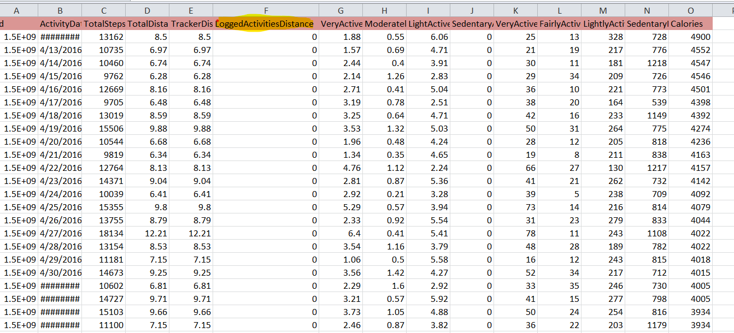
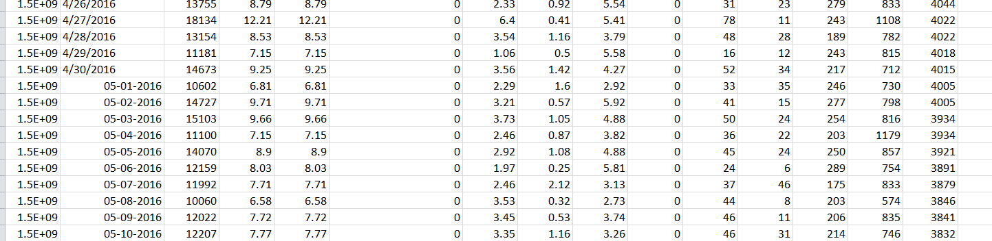
Data Profiling
Fig 1.1
Fig 1.2
Fig 1.3

Slide 8
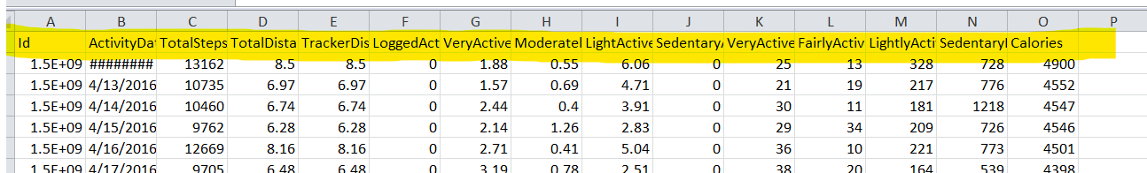
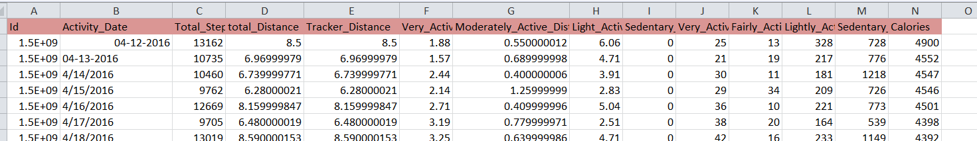
Data Cleaning
Firstly I check for any null or blanks values by using the filters and didn’t find any blank or null value`
Then I fix the column names as per standards
Then I fixed the formats for the Activity_Date column as per examination all the cells doesn’t have the same formats
Fig 1.1`

Slide 9
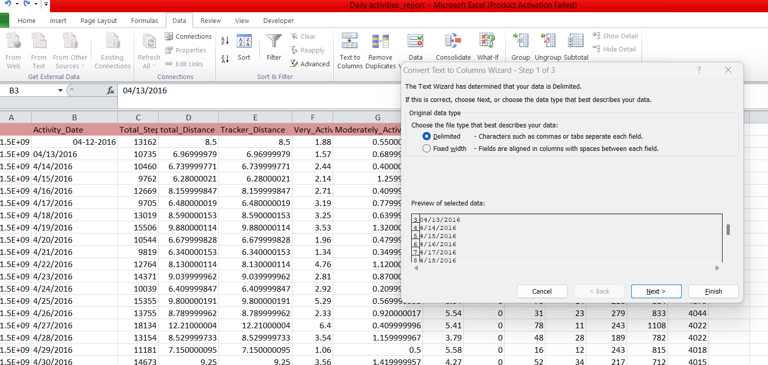
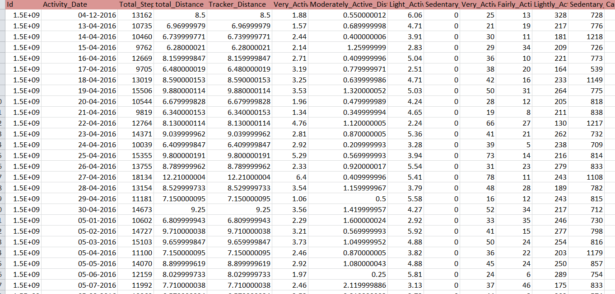
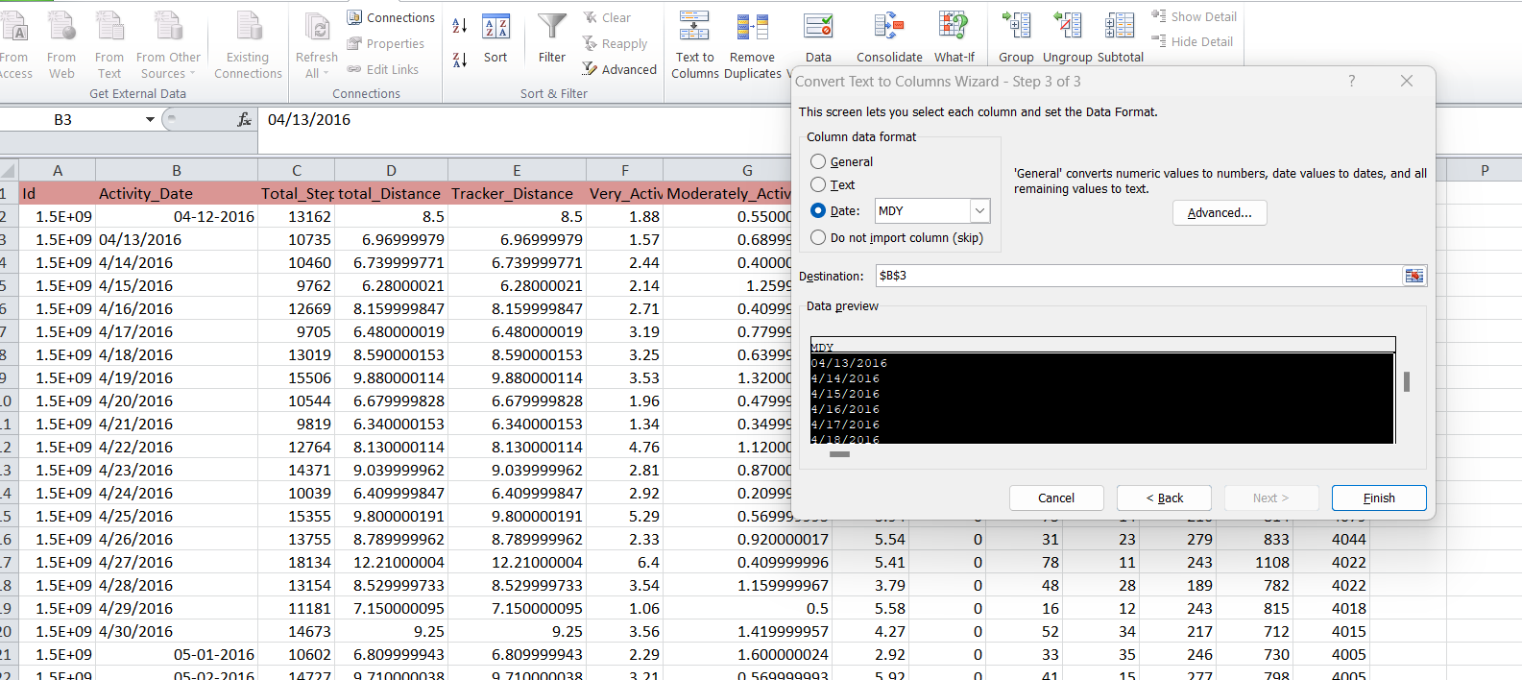
Data Cleaning
Fig 1.1

Slide 10
Import Data To SQL Server
After cleaning the data in the the Excel file we need to upload it in the SQL server database
For that first we need to create a new database named R_Fitness
After creating the new database we import the data into the database
We check the include header files while uploading the Excel file into the database
We need to map the data i.e. matching the attributes of the source table and the destination table
We name the destination table as daily_activities
In SQL while we import the data from Excel
After the data is successfully loaded
We check the data that is imported by running a simple query

Slide 11
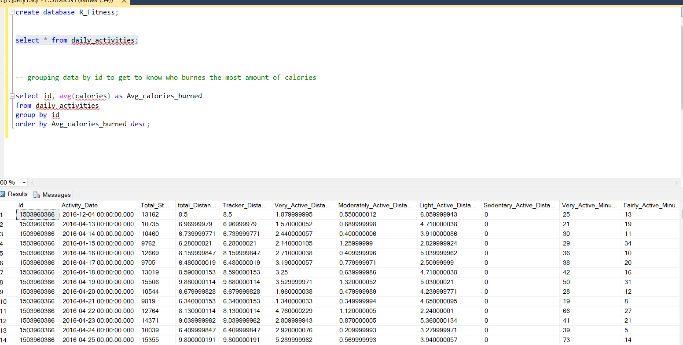
Import Data To SQL Server

Slide 12
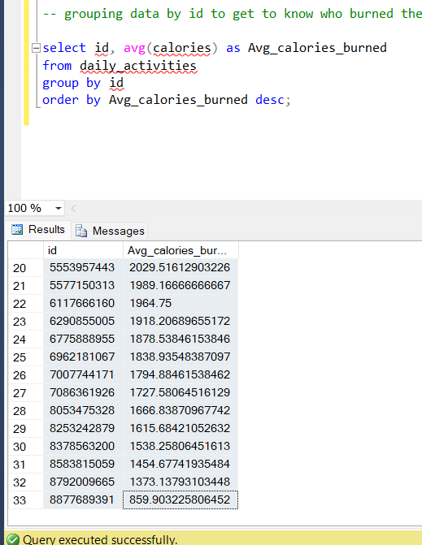
SQL Query Through Analysis
Now after importing the data we can run different queries to get different results
Firstly we group data by id to get to know who burned the most amount of calories

Slide 13
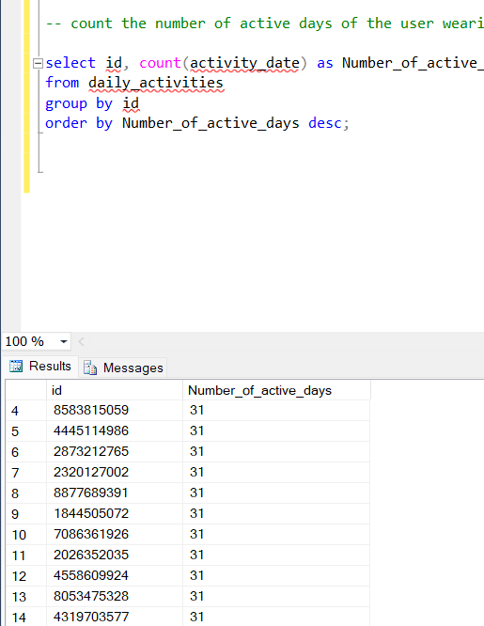
SQL Query Through Analysis
Query to get the customer id with most number of active days

Slide 14
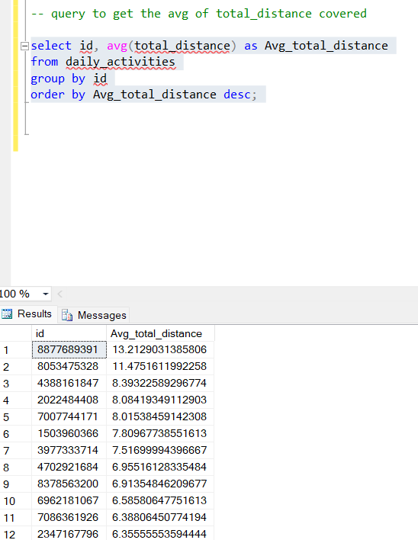
SQL Query Through Analysis
Query to get the average total distance by customer id

Slide 15
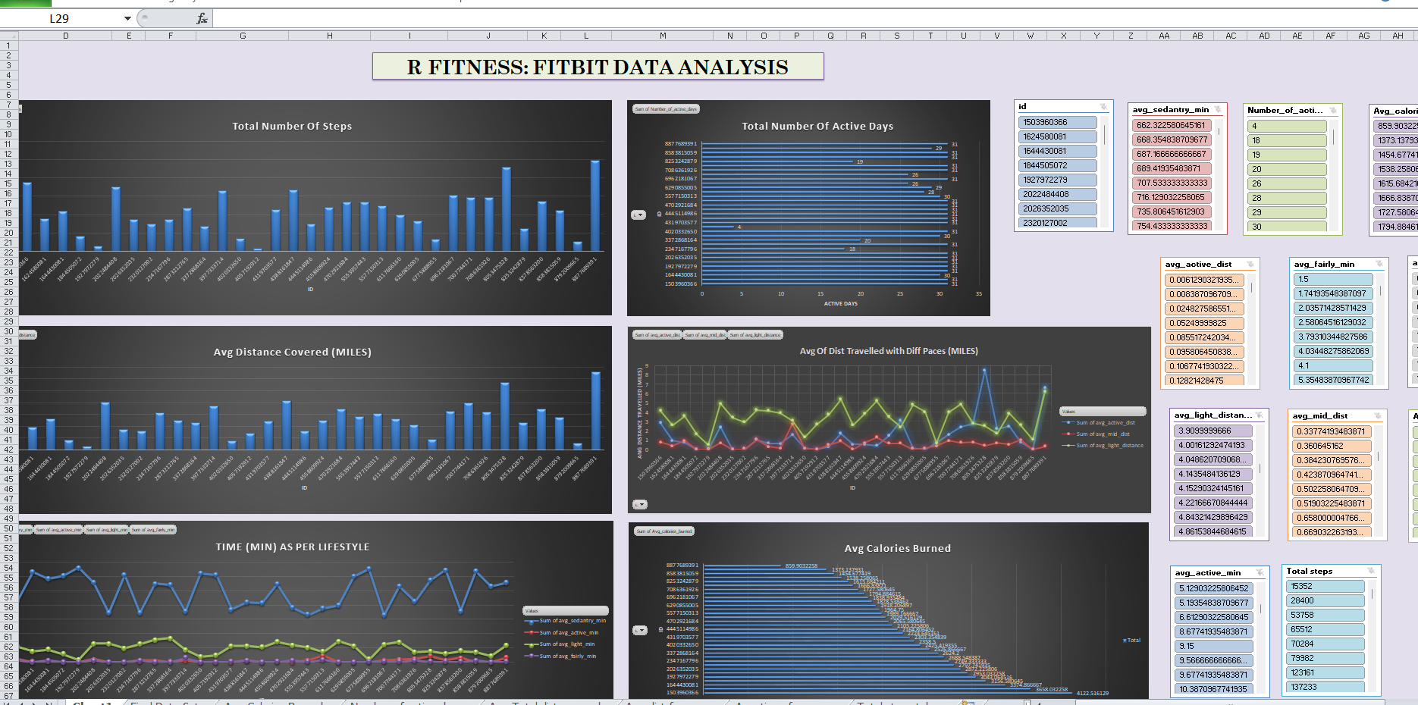
Data Visualization Using Excel

Slide 16

Findings And Suggestions
We get to find the customers who use the FitBit band on daily basis
Separate ad with some extra benefits could be designed for the customers
Users who use the band daily but are lacking results could also be given some suggestions for better results

Slide 17

THANK YOU

